Slide 1


FACE RECOGNITION IN CLASSROOM SET UP
Presented by : U21CS071 | U21CS063 | U21CS096 | U21CS0131
Prasanth Deepak Prajwala Aswin

Slide 2

PROBLEM STATEMENT
To Develop an efficient deep learning-based Siamese network system for real-time classroom attendance, addressing challenges in varying lighting, facial occlusions, multiple student detection, and ensuring biometric data privacy and security.

Slide 3
LITERATURE SURVEY
In developing our proposed methodology for an attendance automation system using facial recognition, we reviewed several key studies that informed our approach:
Face Recognition using Histograms of Oriented Gradients
This paper highlights the robust use of HOG features for face recognition, emphasizing dimensionality reduction to improve accuracy and mitigate overfitting in noisy datasets​
➢Face Recognition using Histograms of Oriented Gradients
This paper highlights the robust use of HOG features for face recognition, emphasizing dimensionality reduction to improve accuracy and mitigate overfitting in noisy datasets​
➢ Smart Attendance System Using CNN
This study introduces a smart attendance system leveraging Convolutional Neural Networks, specifically utilizing Haar classifiers for face detection and Siamese Networks for generating face embeddings​
➢ Student Attendance System Using Face Recognition
This research integrates KNN, CNN, and SVM algorithms for face detection and recognition, combining Gabor filters and Haar classifiers to address challenges like illumination and pose variations​

Slide 4

PROPOSED METHODOLOGY
Siamese Network for Face Classification
Used to classify faces by comparing embeddings of detected faces with those of registered faces in the database.
Determines matches based on the similarity of embeddings.
Haar Cascade Classifier
Fast and lightweight ideal for quickly detecting faces.
Reliable for Face Detection: Provides a good balance of accuracy and efficiency, suitable as a preprocessing step for our project.

Slide 5
WHY SIAMESE?
One-Shot Learning: Can identify new faces with minimal data, ideal for dynamic environments like classrooms.
Feature Matching: Compares embeddings to determine facial similarity effectively.
Scalable and Efficient: Handles large databases without retraining for new entries.
Robust: Performs well despite variations in lighting, pose, and occlusions.

Slide 6
DATASET
Training the Siamese Network
Dataset: A custom dataset comprising labeled individual student images for training. Includes classroom group images for testing to simulate real-world scenarios.
Description: Captures variations in lighting, facial expressions, and angles, ensuring the model is robust and relevant to classroom attendance automation.

Slide 7

FLOW CHART
Input: Classroom Image
↓
Face Detection: Identify and crop individual faces
↓
Feature Extraction: Generate face embeddings using the Siamese Network
↓
Matching: Compare extracted embeddings with the database of registered faces
↓
Output: Names/Roll Numbers of Recognized Faces

Slide 8
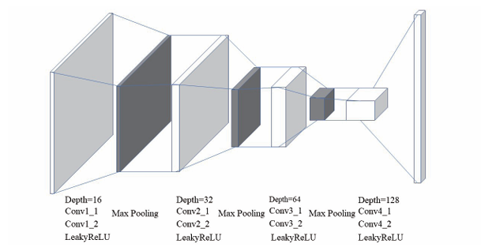
ref. Siamese NN Model.

Slide 9
METHOD USED
Haar Cascade Classifier: Detects and crops faces from the classroom image.
Siamese Network: Generates unique embeddings for each face and compares them with the database to identify matches.

Slide 10
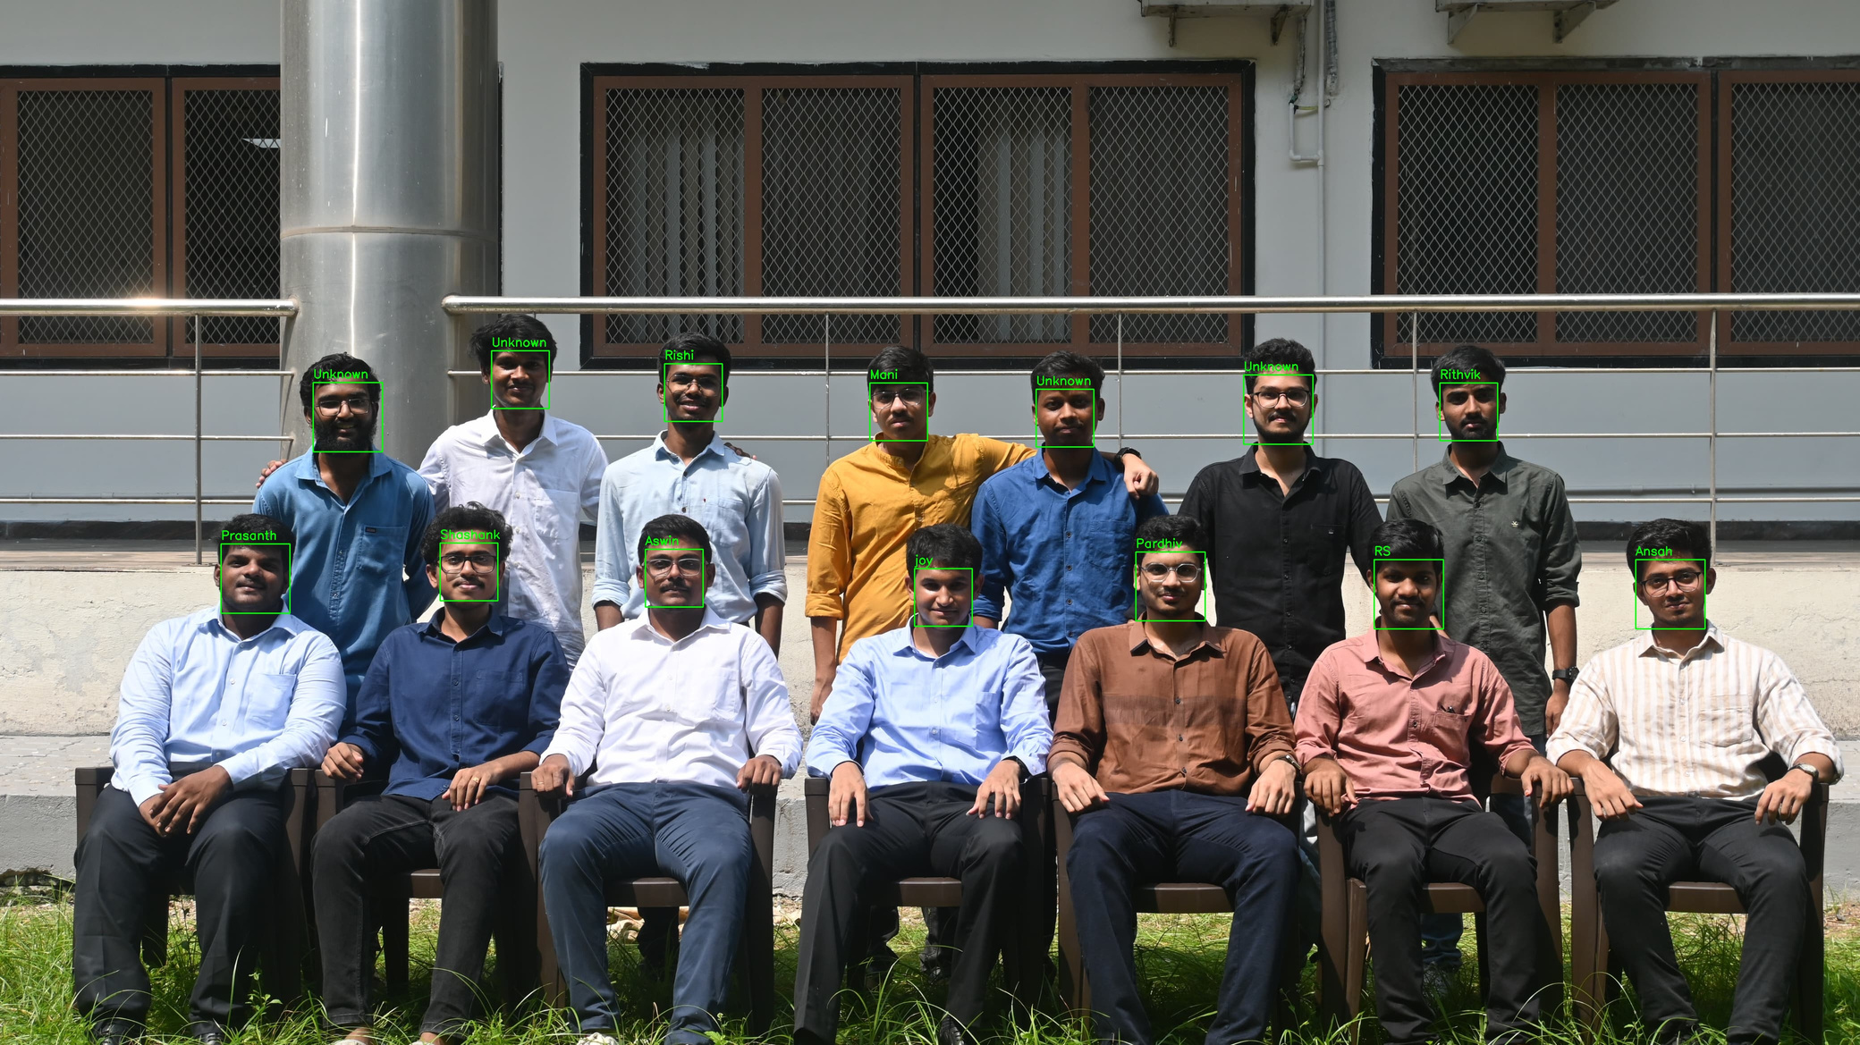
RESULTS

Slide 11
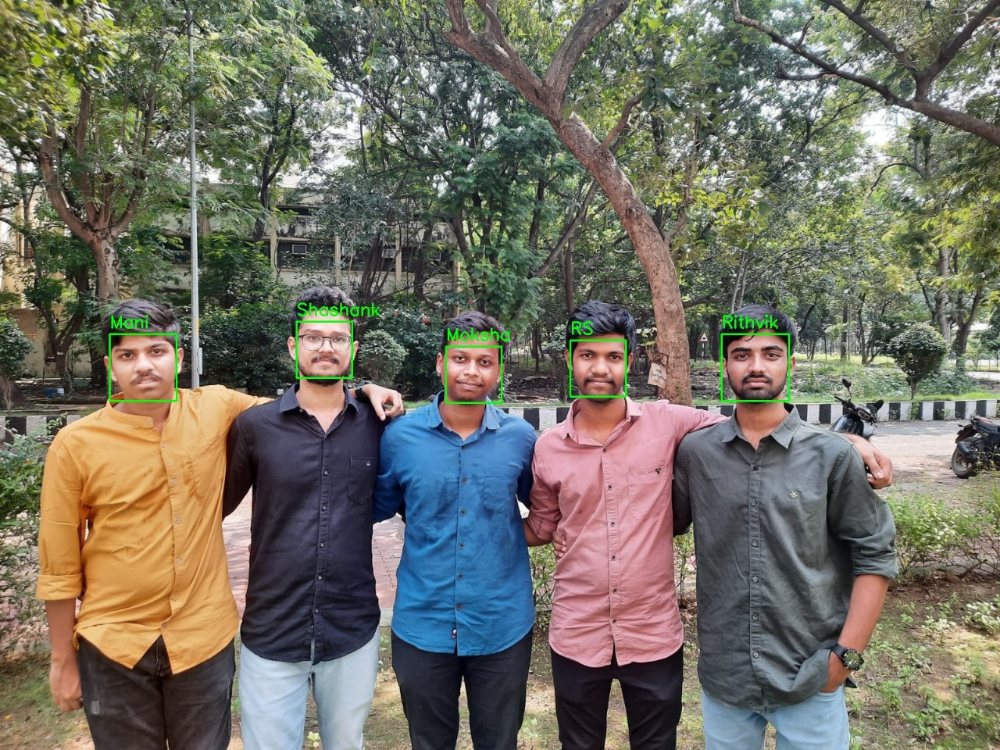
RESULTS

Slide 12
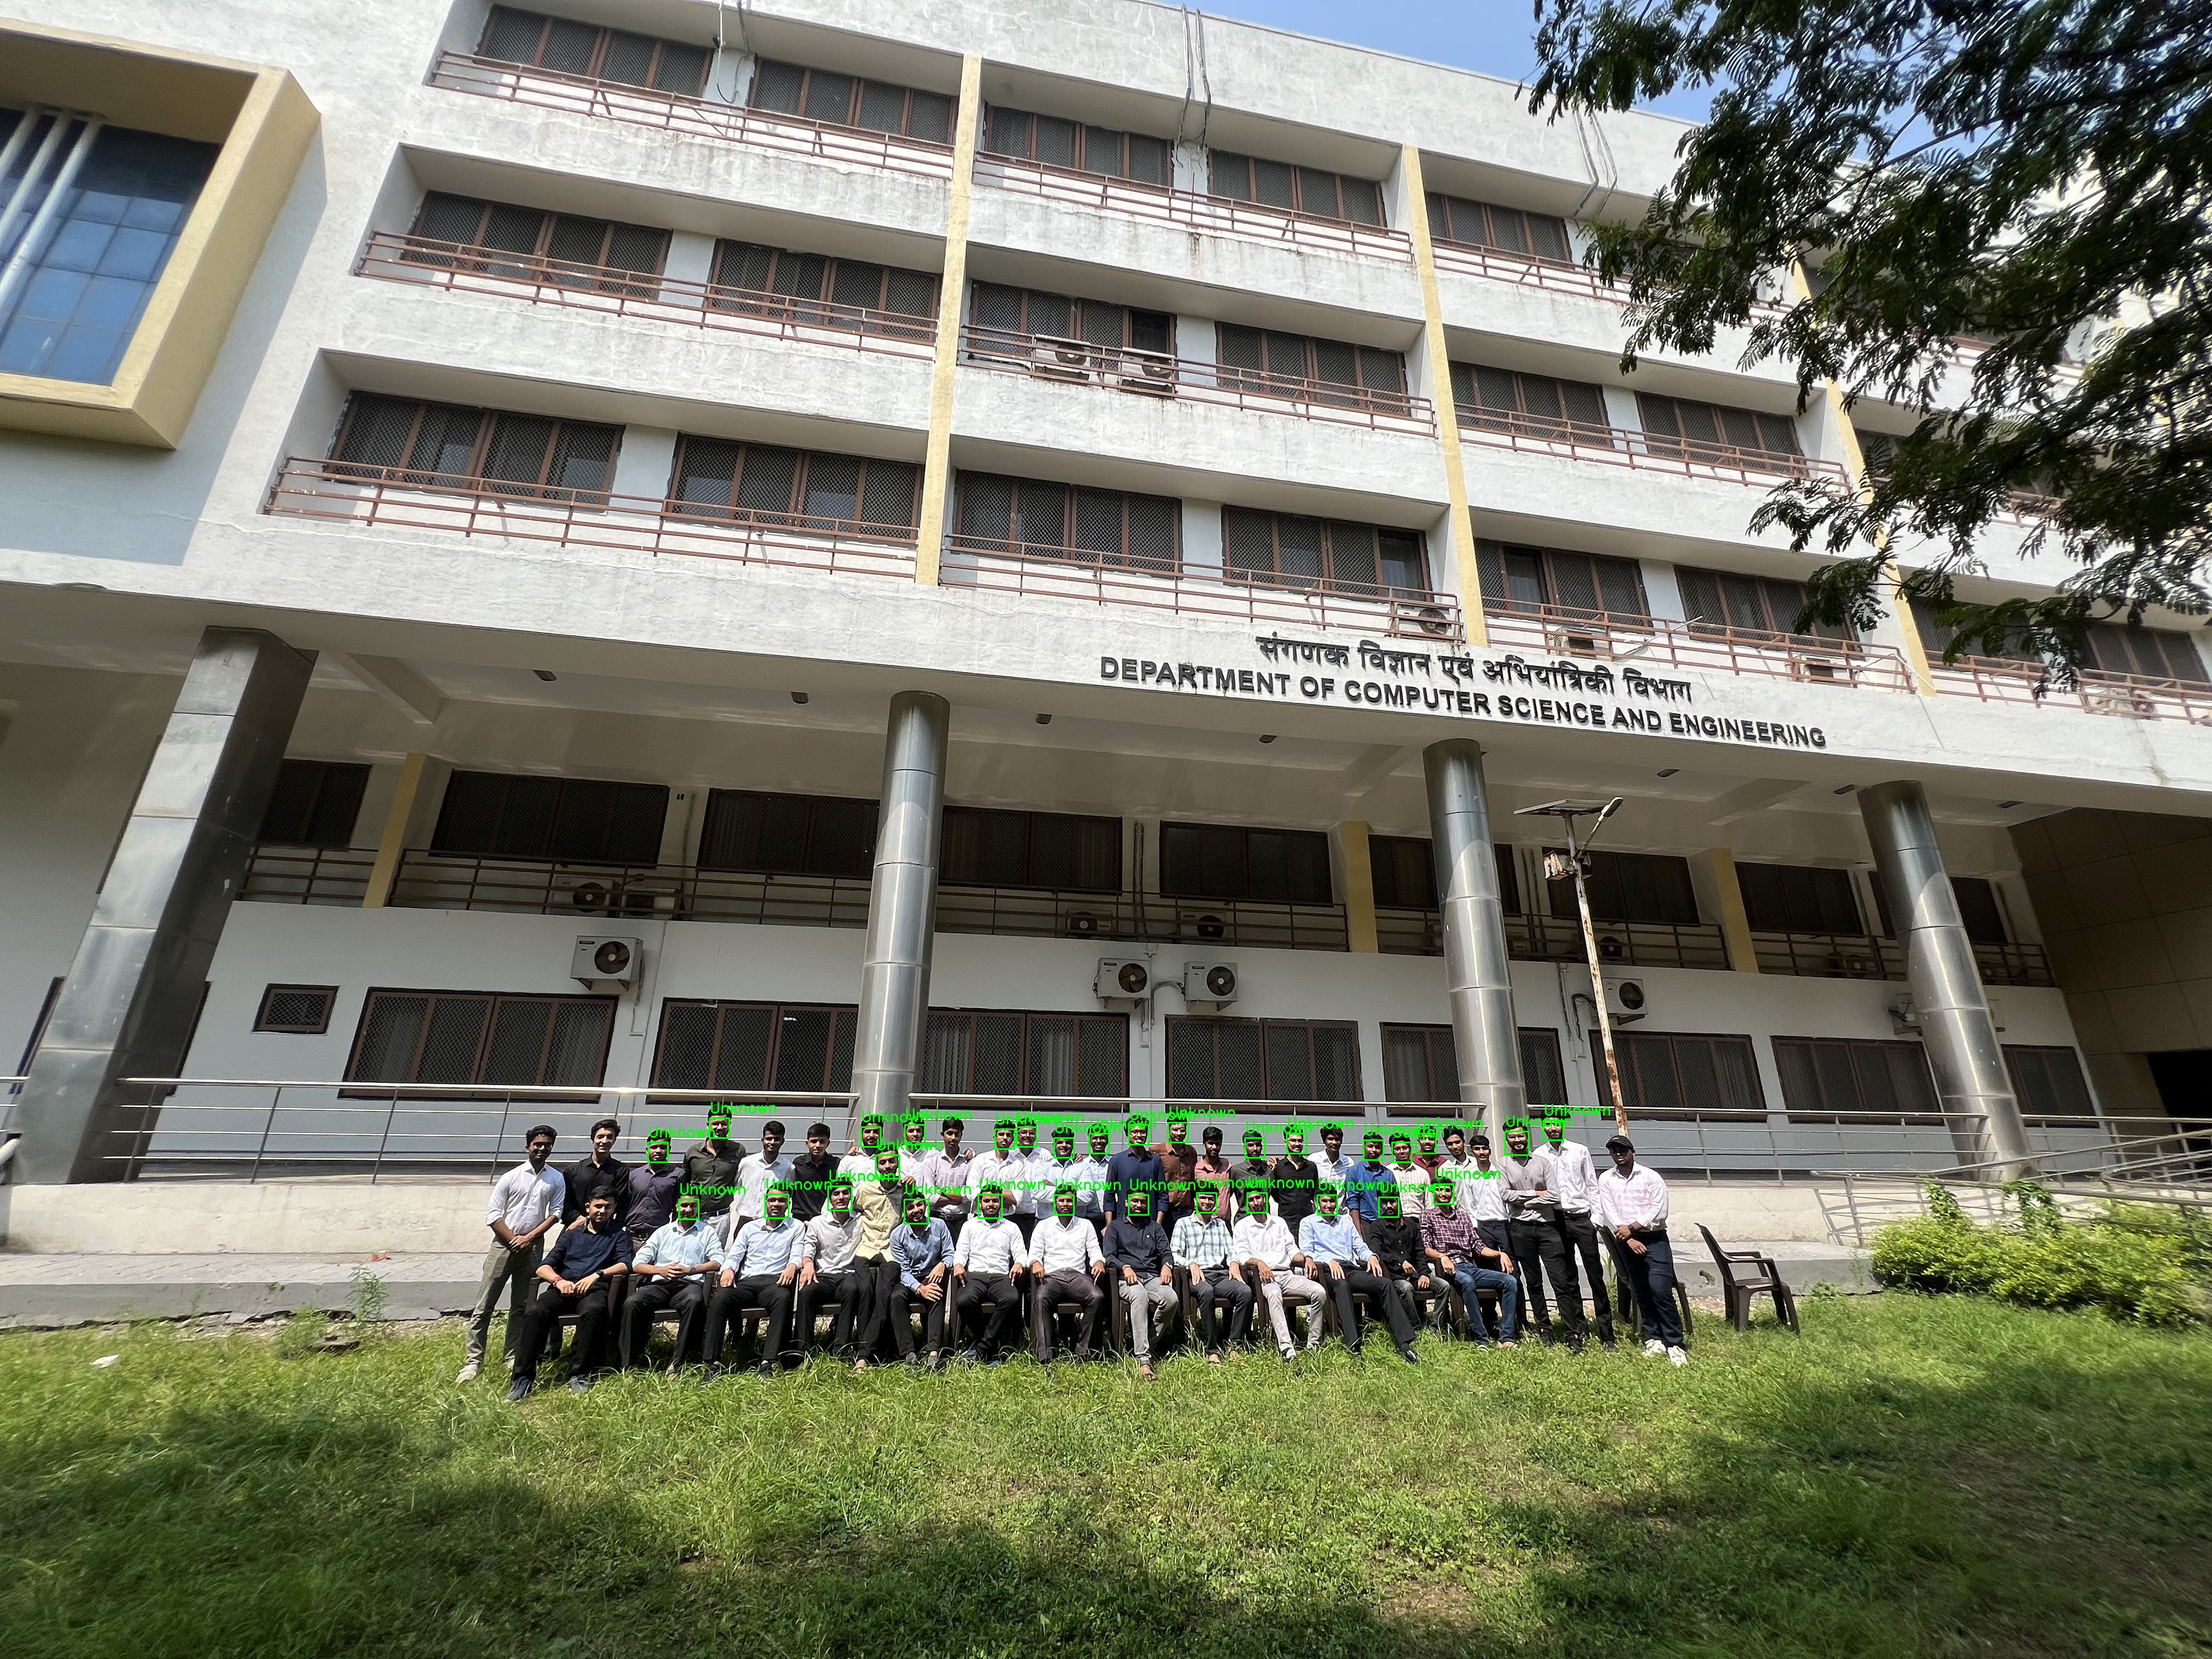
RESULTS

Slide 13
FUTURE WORK
➢
Enhance accuracy by training the model on larger, diverse datasets to handle lighting, angles, and occlusions.
➢
Improve scalability to process multiple classroom images efficiently for larger groups.
➢
Incorporate automated report generation and attendance trend analysis.

Slide 14
CHALLENGES
➢
Managing variations in real-world conditions like uneven lighting, occlusions, and similar facial features.
➢
Ensuring data privacy and ethical handling of student images during dataset creation and model deployment.
Reducing false positives and false negatives while maintaining high-speed processing.
➢

Slide 15

INDIVIDUAL CONTRIBUTIONS
DEEPAK JOY
ASWIN
Learning and Research
Literature Review
Model development
Report making
Learning and Research
Model enhancement
Report making
PRAJWALA
PRASANTH
Learning and Research
Literature Review
Model development
PPT making
Learning and Research
Data collection
Model enhancement
PPT making

Slide 16
THANK YOU

